Slide 1


Nutan Maharashtra Vidya Prasarak Mandal’s NUTAN COLLEGE OF ENGINEERING AND RESEARCH Under Administrative Support of Pimpri Chinchwad Education Trust ISO 21001:2018 EOMS Certified
Seminar / Project Review / Project Presentation
Presentation on
SYSTEM SURVEILLANCE using KEYLOGGER
By
Aman Javed Maner
Roll no. 27
Under the guidance of
Prof. Harshal Mahajan
Department of Computer Science and Engineering
( Artificial Intelligence )

Slide 2

Nutan Maharashtra Vidya Prasarak Mandal’s NUTAN COLLEGE OF ENGINEERING AND RESEARCH Under Administrative Support of Pimpri Chinchwad Education Trust ISO 21001:2018 EOMS Certified
Seminar / Project Review / Project Presentation
About Project
Developed a python code which will simply run in the command prompt and it will send the key logging information to provided email address . Basically we will get to know for which purpose our system is being used by someone else.

Slide 3

Nutan Maharashtra Vidya Prasarak Mandal’s NUTAN COLLEGE OF ENGINEERING AND RESEARCH Under Administrative Support of Pimpri Chinchwad Education Trust ISO 21001:2018 EOMS Certified
Seminar / Project Review / Project Presentation
Introduction
Keyloggers are crucial tools in computer forensics, enabling data recovery and analysis for enhanced data security. They aid in monitoring and tracking users by recording keystrokes, storing the information covertly, and facilitating investigations into ongoing crimes. Keyloggers can be used to retrieve important data during disasters or power failures and are valuable in preserving evidence for forensic analysts and administrators.

Slide 4

Nutan Maharashtra Vidya Prasarak Mandal’s NUTAN COLLEGE OF ENGINEERING AND RESEARCH Under Administrative Support of Pimpri Chinchwad Education Trust ISO 21001:2018 EOMS Certified
Seminar / Project Review / Project Presentation
Problem Statement
Keylogger is basically using keystroke logs to monitor the system and send the details to the admin through the mail server .
Monitors Keystrokes .
Sends mail to the Admin’s mail Id .
Logs keystrokes including special keys .

Slide 5

Nutan Maharashtra Vidya Prasarak Mandal’s NUTAN COLLEGE OF ENGINEERING AND RESEARCH Under Administrative Support of Pimpri Chinchwad Education Trust ISO 21001:2018 EOMS Certified
Seminar / Project Review / Project Presentation
System Requirements
Basic I/O Requirements :
Keyboard , Mouse , Mobile Device & Email Address
Programming Environment :
Python 3.8.0
PyCharm
Program Files Used :
Keylogger.py
Execute_keylogger.py

Slide 6

Nutan Maharashtra Vidya Prasarak Mandal’s NUTAN COLLEGE OF ENGINEERING AND RESEARCH Under Administrative Support of Pimpri Chinchwad Education Trust ISO 21001:2018 EOMS Certified
Seminar / Project Review / Project Presentation
Tools & Technology Used
Modules used :
Smtplib :
The module included in python defines an SMTP client session object that can be used to send mail to any internet machine with an SMTP listener daemon.
Threading :
It is one of the modules provided with python includes a simple-to-implement locking mechanism that allows you to synchronize threads.
Pynput:
This library allows the users to control and monitor input devices. e.g.; pynput.mouse, pynput.keyboard.

Slide 7
Nutan Maharashtra Vidya Prasarak Mandal’s NUTAN COLLEGE OF ENGINEERING AND RESEARCH Under Administrative Support of Pimpri Chinchwad Education Trust ISO 21001:2018 EOMS Certified
Seminar / Project Review / Project Presentation
Purpose of Project
Keyloggers provide the best solutions in case of such cases like;
IT organizations can indicate their concerns by going after the culprit whose performance is deteriorating that of the whole organization, parents can maintain a check on their children’s activities, a particular person’s activities can be monitored, storing passwords of various social media profiles. Above all, keylogger is one of the best implementation of fundamentals of ethical hacking. By using this some measures could be done accordingly that would save personal data from being in the hands of total strangers

Slide 8
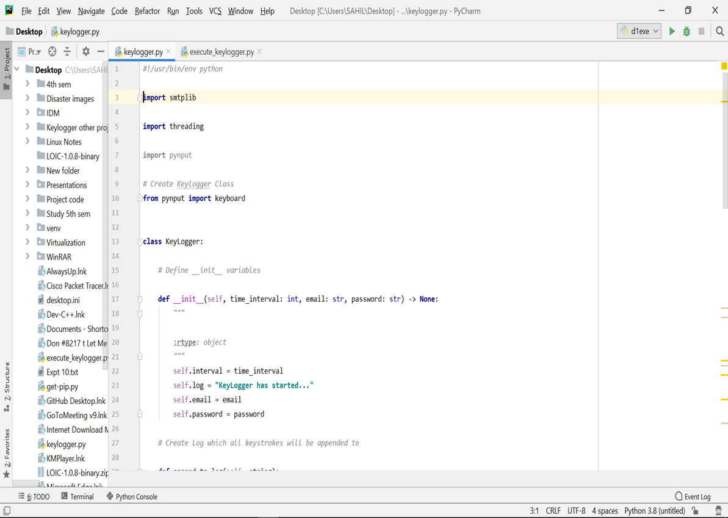
Nutan Maharashtra Vidya Prasarak Mandal’s NUTAN COLLEGE OF ENGINEERING AND RESEARCH Under Administrative Support of Pimpri Chinchwad Education Trust ISO 21001:2018 EOMS Certified
Seminar / Project Review / Project Presentation
Code Screenshots

Slide 9
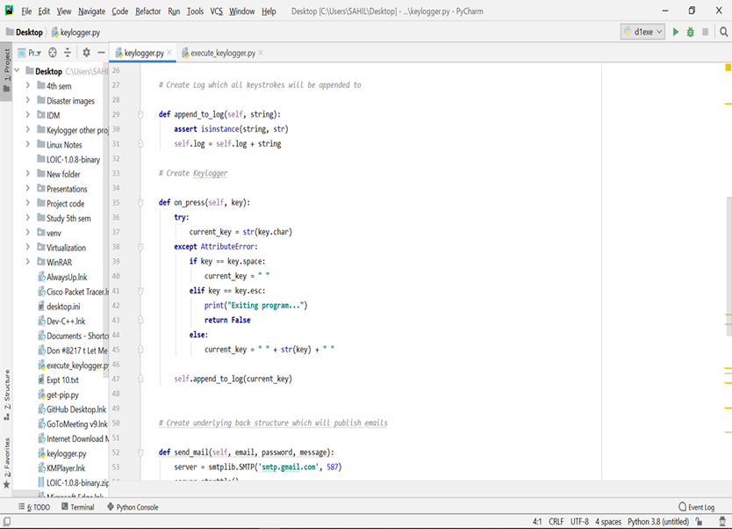
Nutan Maharashtra Vidya Prasarak Mandal’s NUTAN COLLEGE OF ENGINEERING AND RESEARCH Under Administrative Support of Pimpri Chinchwad Education Trust ISO 21001:2018 EOMS Certified
Seminar / Project Review / Project Presentation

Slide 10
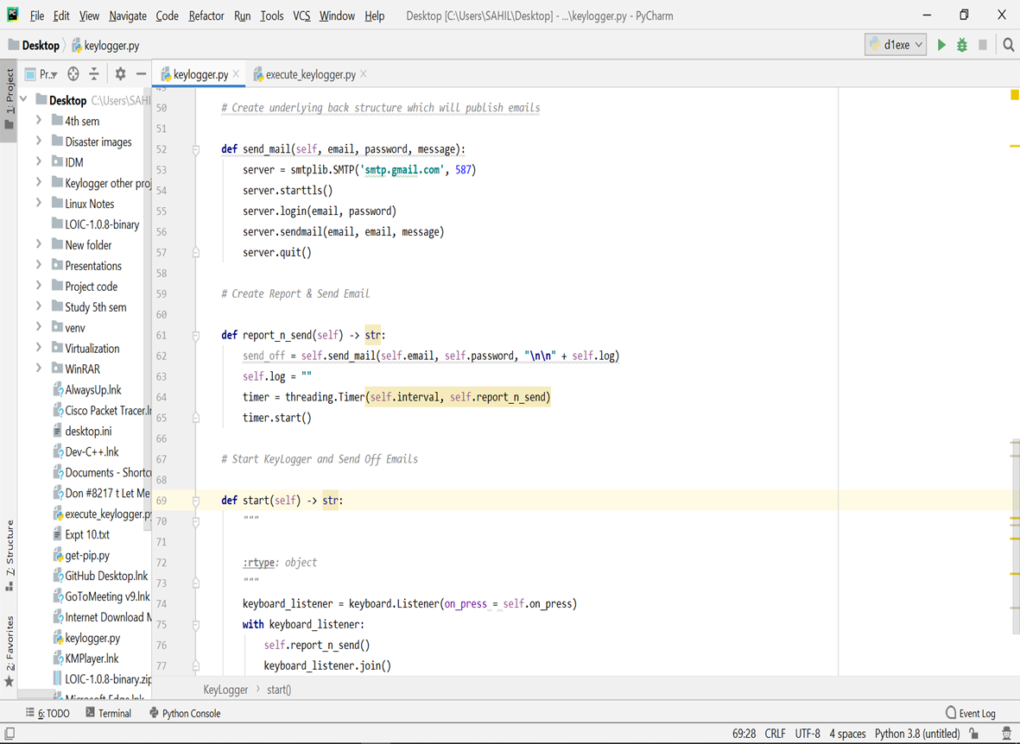
Nutan Maharashtra Vidya Prasarak Mandal’s NUTAN COLLEGE OF ENGINEERING AND RESEARCH Under Administrative Support of Pimpri Chinchwad Education Trust ISO 21001:2018 EOMS Certified
Seminar / Project Review / Project Presentation

Slide 11
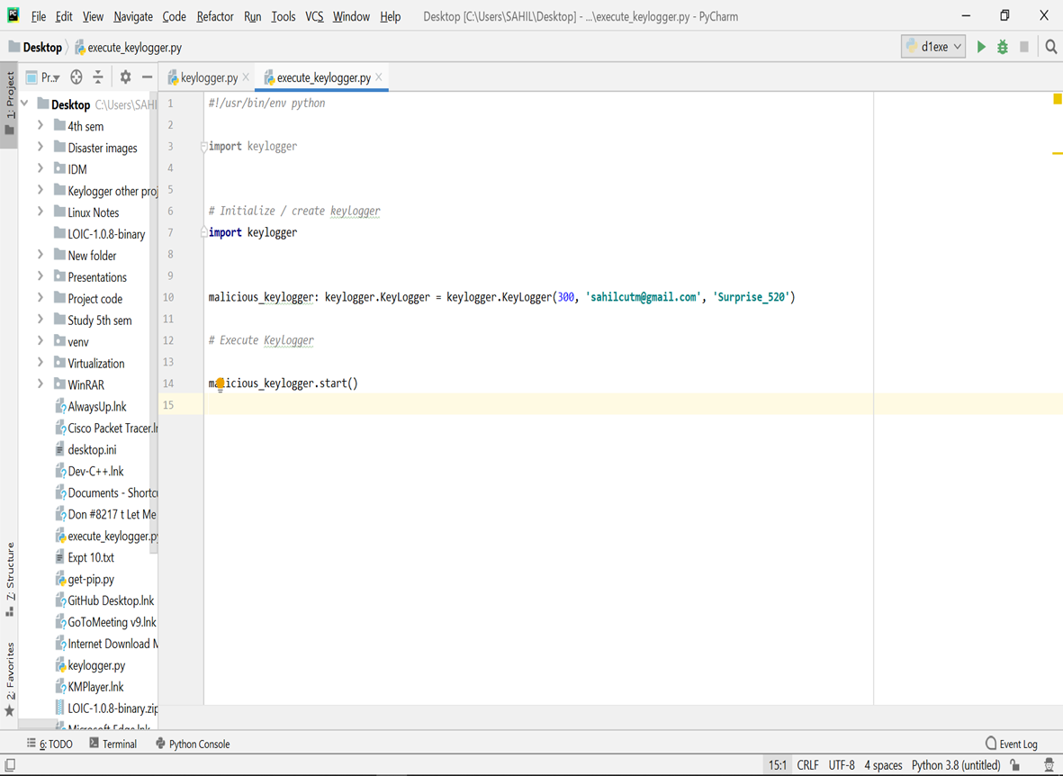
Nutan Maharashtra Vidya Prasarak Mandal’s NUTAN COLLEGE OF ENGINEERING AND RESEARCH Under Administrative Support of Pimpri Chinchwad Education Trust ISO 21001:2018 EOMS Certified
Seminar / Project Review / Project Presentation

Slide 12
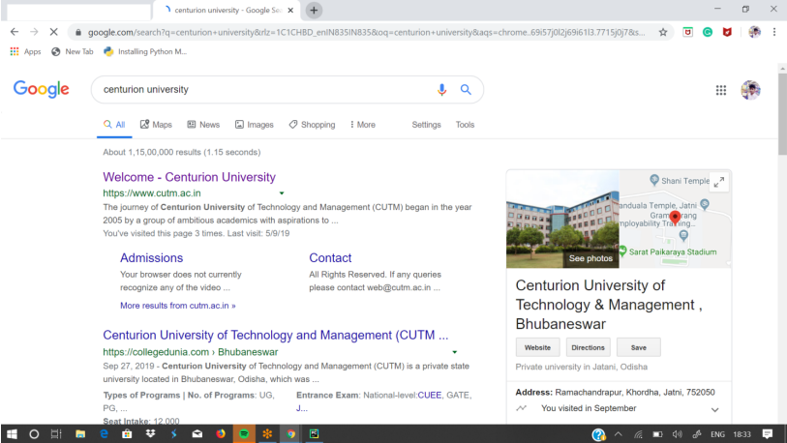
Nutan Maharashtra Vidya Prasarak Mandal’s NUTAN COLLEGE OF ENGINEERING AND RESEARCH Under Administrative Support of Pimpri Chinchwad Education Trust ISO 21001:2018 EOMS Certified
Seminar / Project Review / Project Presentation
Output Screenshot

Slide 13
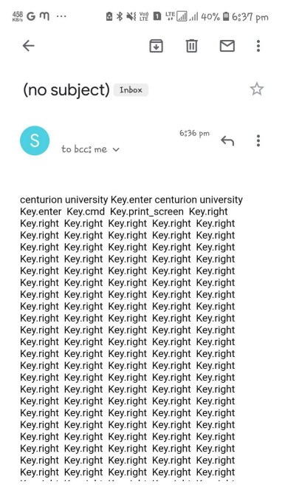
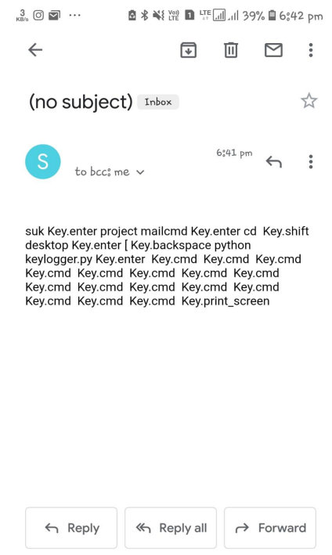
Nutan Maharashtra Vidya Prasarak Mandal’s NUTAN COLLEGE OF ENGINEERING AND RESEARCH Under Administrative Support of Pimpri Chinchwad Education Trust ISO 21001:2018 EOMS Certified
Seminar / Project Review / Project Presentation

Slide 14

Nutan Maharashtra Vidya Prasarak Mandal’s NUTAN COLLEGE OF ENGINEERING AND RESEARCH Under Administrative Support of Pimpri Chinchwad Education Trust ISO 21001:2018 EOMS Certified
Seminar / Project Review / Project Presentation
Futurescope
To implement the following in the project :
Adding screenshots of pages visited
Recording of system screen
Full remote cloud monitoring
Screenshot of immediately changed pages
Secure web account for data storing
Password Protection
Parental Control

Slide 15
Nutan Maharashtra Vidya Prasarak Mandal’s NUTAN COLLEGE OF ENGINEERING AND RESEARCH Under Administrative Support of Pimpri Chinchwad Education Trust ISO 21001:2018 EOMS Certified
Seminar / Project Review / Project Presentation

Slide 16
Nutan Maharashtra Vidya Prasarak Mandal’s NUTAN COLLEGE OF ENGINEERING AND RESEARCH Under Administrative Support of Pimpri Chinchwad Education Trust ISO 21001:2018 EOMS Certified
Seminar / Project Review / Project Presentation

